Slide 1
Strings

Slide 2
The C++ string Class
Special data type supports working with strings
#include <string>
Can define string variables in programs:
  string firstName, lastName;
Can receive values with assignment operator:
  firstName = "George";
  lastName = "Washington";
Can be displayed via cout
  cout << firstName << " " << lastName;
10-<number>

Slide 3
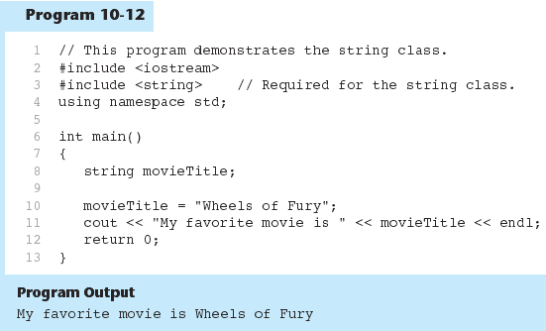
10-<number>

Slide 4
Input into a string Object
Use cin >> to read an item into a string:
  string firstName;
  cout << "Enter your first name: ";
  cin >> firstName;
10-<number>

Slide 5
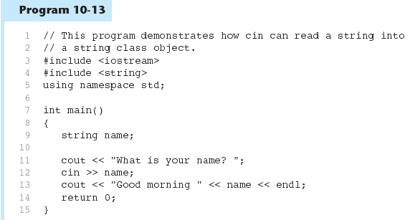
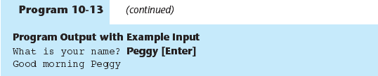
10-<number>

Slide 6
Input into a string Object
Use getline function to put a line of input, possibly including spaces, into a string:
  string address;
  cout << "Enter your address: ";
  getline(cin,address);
10-<number>

Slide 7
string Comparison
Can use relational operators directly to compare string objects:
  string str1 = "George",
  str2 = "Georgia";
  if (str1 < str2)
  cout << str1 << " is less than "
  << str2;
Comparison is performed similar to strcmp function. Result is true or false
10-<number>

Slide 8
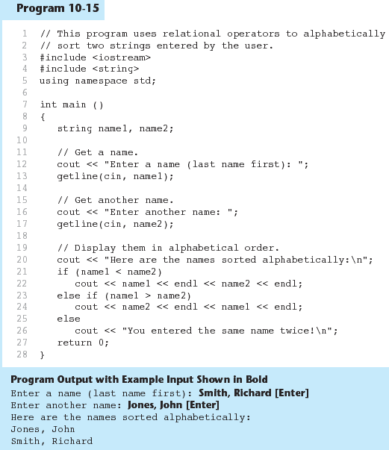
10-<number>

Slide 9
Other Definitions of C++ strings
Definition | Meaning
string name; | defines an empty string object
string myname("Chris"); | defines a string and initializes it
string yourname(myname); | defines a string and initializes it
string aname(myname, 3); | defines a string and initializes it with first 3 characters of myname
string verb(myname,3,2); | defines a string and initializes it with 2 characters from myname starting at position 3
string noname(5,'A'); | defines string and initializes it to 5 'A's
10-<number>

Slide 10
string Operators
OPERATOR | MEANING
>> | extracts characters from stream up to whitespace, insert into string
<< | inserts string into stream
= | assigns string on right to string object on left
+= | appends string on right to end of contents on left
+ | concatenates two strings
[] | references character in string using array notation
>, >=, <, <=, ==, != | relational operators for string comparison. Return true or false
10-<number>

Slide 11
string Operators
string word1, phrase;
string word2 = " Dog";
cin >> word1; // user enters "Hot Tamale"
// word1 has "Hot"
phrase = word1 + word2; // phrase has
// "Hot Dog"
phrase += " on a bun";
for (int i = 0; i < 16; i++)
cout << phrase[i]; // displays
// "Hot Dog on a bun"
10-<number>

Slide 12
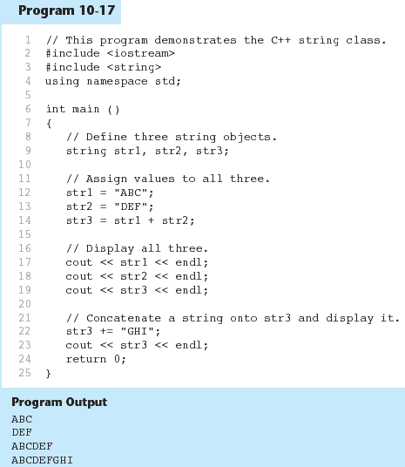
10-<number>

